Slide 1
Describing Location in a Distribution
Warmup
Brittany is 5’7” tall and her boyfriend Freddie is 6’ tall? The height of females has a mean of 64 inches with a standard deviation of 2.5 inches and the height of males has a mean of 69 inches with a standard deviation of 3 inches. Who is relatively taller for their gender?
Jamal’s SAT Math score of 550 beat 12,000 of the 19,000 students who sat for the test. What percentile was his score?

Slide 2
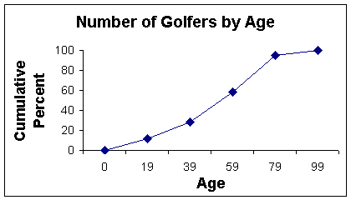
Describing Location in a Distribution
Using the cumulative relative frequency graph above:
What percentile is an age of 30?
What age is the 80th percentile?
What is the median age?

Slide 3
Section 2.1 Describing Location in a Distribution
Learning Objectives
After this section, you should be able to…
MEASURE position using percentiles
INTERPRET cumulative relative frequency graphs
MEASURE position using z-scores
TRANSFORM data
DEFINE and DESCRIBE density curves

Slide 4
Describing Location in a Distribution
Transforming Data
Transforming converts the original observations from the original units of measurements to another scale. Transformations can affect the shape, center, and spread of a distribution.
Effect of Adding (or Subracting) a Constant
Adding the same number a (either positive, zero, or negative) to each observation:
adds a to measures of center and location (mean, median, quartiles, percentiles), but
Does not change the shape of the distribution or measures of spread (range, IQR, standard deviation).
A math test has a mean of 60 and a standard deviation of 12. The teacher wants the class average higher so he adds 15 points to every grade. What is the mean and standard deviation of the new grades?

Slide 5
Describing Location in a Distribution
Transforming Data
Effect of Multiplying (or Dividing) by a Constant
Multiplying (or dividing) each observation by the same number b (positive, negative, or zero):
multiplies (divides) measures of center and location by b
multiplies (divides) measures of spread by |b|, but
does not change the shape of the distribution
A math test has a mean of 60 and a standard deviation of 12. The teacher wants the class average higher so he multiplies every grade by 1.25. What is the mean and standard deviation of the new grades?

Slide 6
Describing Location in a Distribution
Transformation Example
Statistic | Original (y) | y+10 | 2y | 2y+20
Mean | 30
Median | 32
IQR | 8
Standard Dev | 6
Minimum | 22
Q₁ | 27
Your score | 35

Slide 7
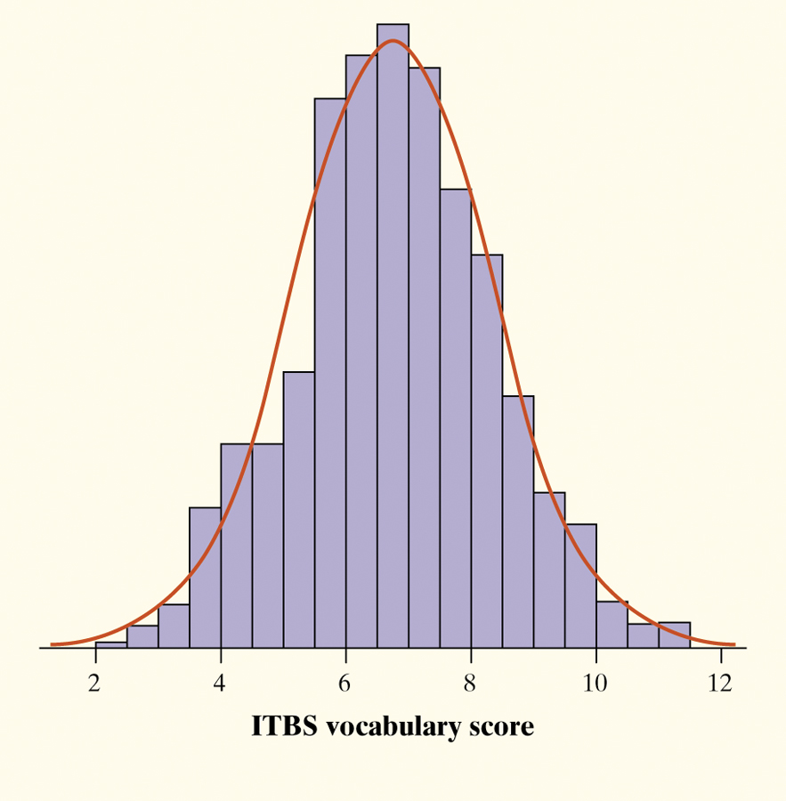
Describing Location in a Distribution
Density Curve
Definition:
A density curve is a curve that
is always on or above the horizontal axis, and
has area exactly 1 underneath it.
the area under the curve is the proportion of all observations that fall in that interval.
Sometimes the overall pattern of a large number of observations is so regular that we can describe it by a smooth curve.

Slide 8
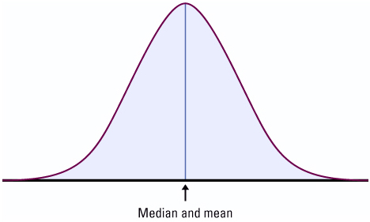
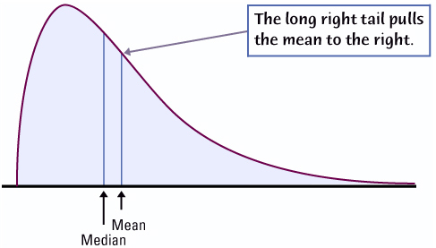
Density Curves
Density Curves come in many different shapes; symmetric, skewed, uniform, etc.
The area of a region of a density curve represents the % of observations that fall in that region.
The median of a density curve cuts the area in half.
The mean of a density curve is its “balance point.”

Slide 9
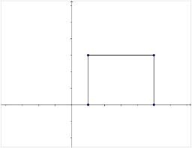
Describing Location in a Distribution
Uniform Density Curve
What is the height of the box?
1 2 3 4 5
What is the height of the box?
What proportion of values are less than 2?
What proportion of values are greater than 3.5?
What proportion of values are between 2.5 and 4?

Slide 10
Section 2.1 Describing Location in a Distribution
Summary
In this section, we learned that…
There are two ways of describing an individual’s location within a distribution – the percentile and z-score.
A cumulative relative frequency graph allows us to examine location within a distribution.
It is common to transform data, especially when changing units of measurement. Transforming data can affect the shape, center, and spread of a distribution.
We can sometimes describe the overall pattern of a distribution by a density curve (an idealized description of a distribution that smooths out the irregularities in the actual data).

Slide 11
Looking Ahead…
In the next Section…
We’ll learn about one particularly important class of density curves – the Normal Distributions
We’ll learn
The 68-95-99.7 Rule
The Standard Normal Distribution
Normal Distribution Calculations, and
Assessing Normality

