Slide 1
Warmup
What is the difference between a debit and a credit?
What 4 pieces of information are required to be entered in the check register when you write a check?

Slide 2
3-2 RECONCILE A BANK STATEMENT
OBJECTIVES
Reconcile a checking account with a bank statement by hand and by using a spreadsheet.

Slide 3
Reconciling a Bank Statement
Why is it important to reconcile the check register monthly?
What problems could arise if you think you have more in your account than the bank knows you have?

Slide 4
EXAMPLE 1
Reconciling a bank statement
- Revised statement balance = ending statement balance + outstanding deposits – outstanding debits (withdrawals, charges, and bank fees)
A reconciled bank statement is when the revised statement balance = check register balance.
Nancy has a balance of $1,078 in her check register. The balance on her bank account statement is $885.84. Not reported on her bank statement are deposits of $575 and $250 and two checks for $195 and $437.84. Is her check register balanced? Explain.

Slide 5
EXAMPLE 2
Marina and Brian have a joint checking account. They have a balance of $3,839.25 in the check register. The balance on the bank statement is $3,450.10. Not reported on the statement are deposits of $2,000, $135.67, $254.77, and $188.76 and four checks for $567.89, $23.83, $598.33, and $1,000. Reconcile the bank statement.

Slide 6
Example 3
Reconcile Michael’s bank statement with his checkbook

Slide 7
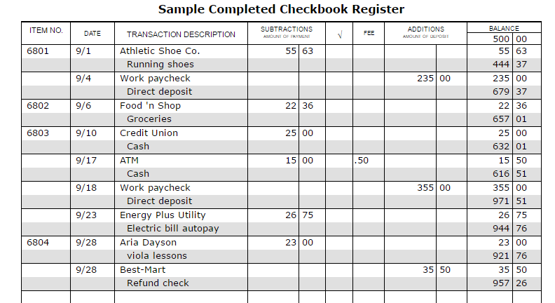
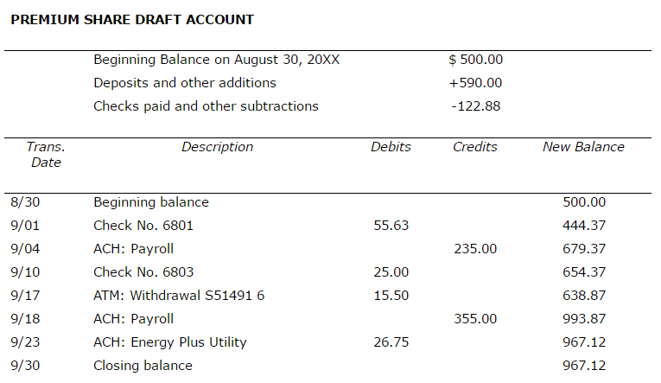
EXAMPLE 4
Reconcile the bank statement with the check register

