Slide 1
Probability Rules
Warmup
The chance of winning a prize from Herff-Jones is 1/22. How would you set up a simulation using the random number table to determine the probability of a group of 5 friends winning at least 1 prize?

Slide 2
Section 5.2 Probability Rules
Learning Objectives
After this section, you should be able to…
DESCRIBE chance behavior with a probability model
DEFINE and APPLY basic rules of probability
DETERMINE probabilities from two-way tables
CONSTRUCT Venn diagrams and DETERMINE probabilities

Slide 3
Probability Rules
Probability Models
In Section 5.1, we used simulation to imitate chance behavior. Fortunately, we don’t have to always rely on simulations to determine the probability of a particular outcome.
Descriptions of chance behavior contain two parts:
Definition:
The sample space S of a chance process is the set of all possible outcomes.
A probability model is a description of some chance process that consists of two parts: a sample space S and a probability for each outcome.

Slide 4
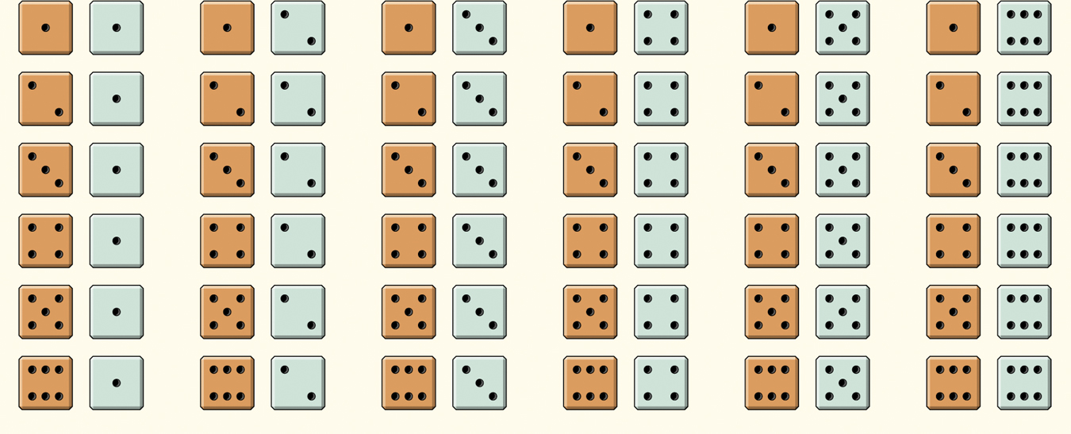
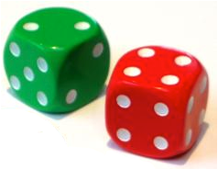
Probability Rules
Example: Roll the Dice
Give a probability model for the chance process of rolling two fair, six-sided dice
Sample Space
36 Outcomes
Since the dice are fair, each outcome is equally likely.
Each outcome has probability 1/36.

Slide 5
Probability Rules
Probability Models
Probability models allow us to find the probability of any collection of outcomes.
Definition:
An event is any collection of outcomes from some chance process. That is, an event is a subset of the sample space. Events are usually designated by capital letters, like A, B, C, and so on.
If A is any event, we write its probability as P(A).
In the dice-rolling example, suppose we define event A as “sum is 5.”
There are 4 outcomes that result in a sum of 5.
Since each outcome has probability 1/36, P(A) = 4/36.
Suppose event B is defined as “sum is not 5.” What is P(B)?
P(B) = 1 – 4/36
= 32/36

Slide 6
Probability Rules
Basic Rules of Probability
All probability models must obey the following rules:
The probability of any event is a number between 0 and 1.
All possible outcomes together must have probabilities whose sum is 1.
If all outcomes in the sample space are equally likely, the probability that event A occurs can be found using the formula
The probability that an event does not occur is 1 minus the probability that the event does occur.
If two events have no outcomes in common, the probability that one or the other occurs is the sum of their individual probabilities.
Definition:
Two events are mutually exclusive (disjoint) if they have no outcomes in common and so can never occur together.

Slide 7
Probability Rules
Basic Rules of Probability
For any event A, 0 ≤ P(A) ≤ 1.
If S is the sample space in a probability model,
P(S) = 1.
In the case of equally likely outcomes,
Complement rule: P(A^{C}) = 1 – P(A)
Addition rule for mutually exclusive events: If A and B are mutually exclusive,
P(A or B) = P(A) + P(B).

Slide 8
Probability Rules
Example: Distance Learning
Distance-learning courses are rapidly gaining popularity among college students. Randomly select an undergraduate student who is taking distance-learning courses for credit and record the student’s age. Here is the probability model:
Age group (yr): | 18 to 23 | 24 to 29 | 30 to 39 | 40 or over
Probability: | 0.57 | 0.17 | 0.14 | 0.12
Show that this is a legitimate probability model.
Find the probability that the chosen student is between 24 and 39 years old
Find the probability that the chosen student is not in the traditional college age group (18 to 23 years).

Slide 9
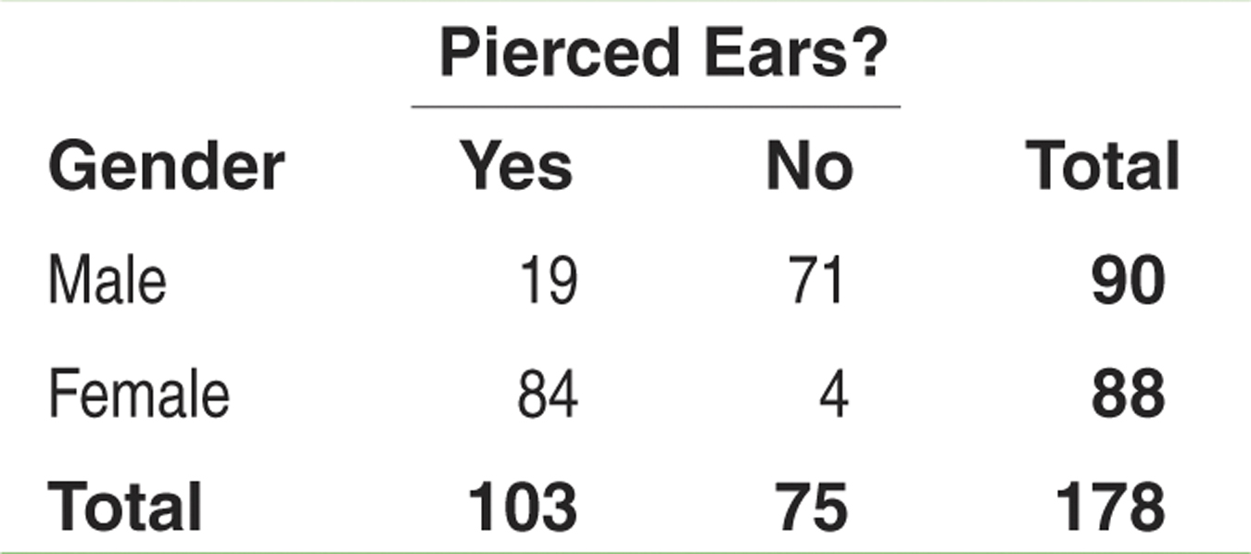
Probability Rules
Two-Way Tables and Probability
When finding probabilities involving two events, a two-way table can display the sample space in a way that makes probability calculations easier.
Consider the example on page 303. Suppose we choose a student at random. Find the probability that the student
has pierced ears.
is a male with pierced ears.
is a male or has pierced ears.
Define events A: is male and B: has pierced ears.
(a) Each student is equally likely to be chosen. 103 students have pierced ears. So, P(pierced ears) = P(B) = 103/178.
(b) We want to find P(male and pierced ears), that is, P(A and B). Look at the intersection of the “Male” row and “Yes” column. There are 19 males with pierced ears. So, P(A and B) = 19/178.
(c) We want to find P(male or pierced ears), that is, P(A or B). There are 90 males in the class and 103 individuals with pierced ears. However, 19 males have pierced ears – don’t count them twice!
P(A or B) = (19 + 71 + 84)/178. So, P(A or B) = 174/178

Slide 10
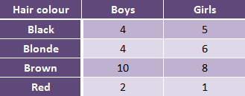
Probability Rules
Example 1
What is the probability a girl has blonde hair?
What is the probability a child with brown hair is a boy?
What is the probability a child is a girl or has red hair?

Slide 11
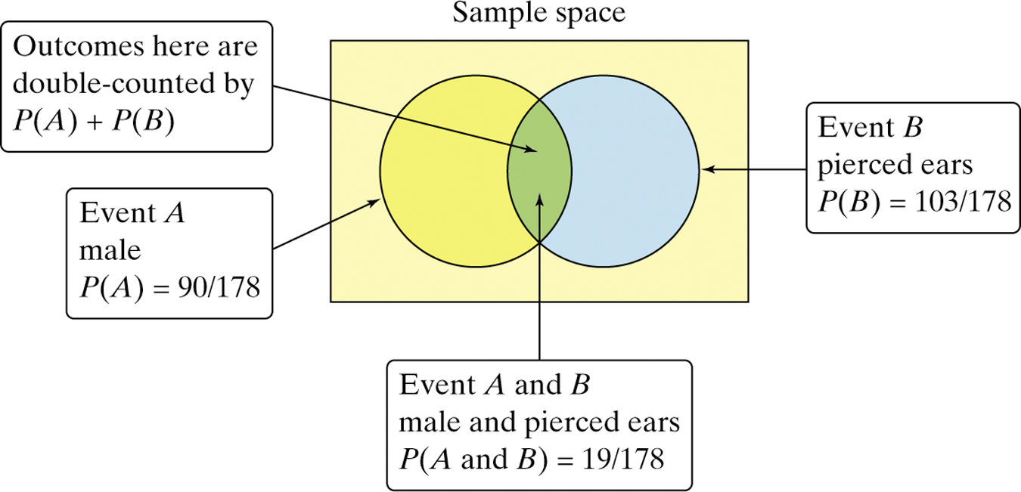
Probability Rules
Two-Way Tables and Probability
Note, the previous example illustrates the fact that we can’t use the addition rule for mutually exclusive events unless the events have no outcomes in common.
The Venn diagram below illustrates why.
General Addition Rule for Two Events
If A and B are any two events resulting from some chance process, then
P(A or B) = P(A) + P(B) – P(A and B)

Slide 12
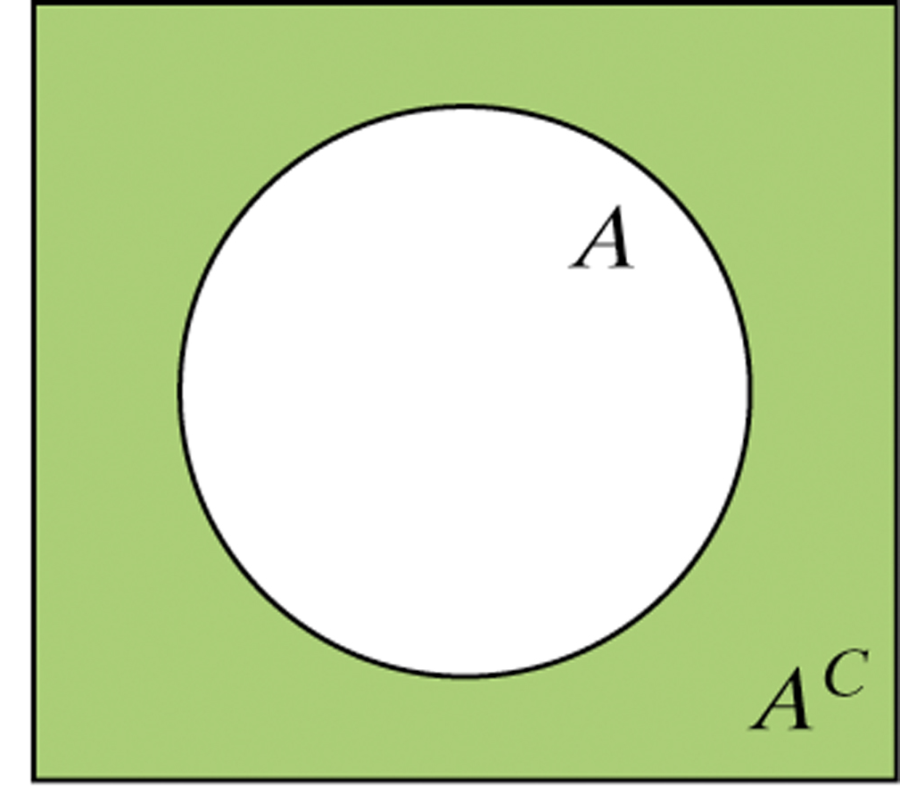
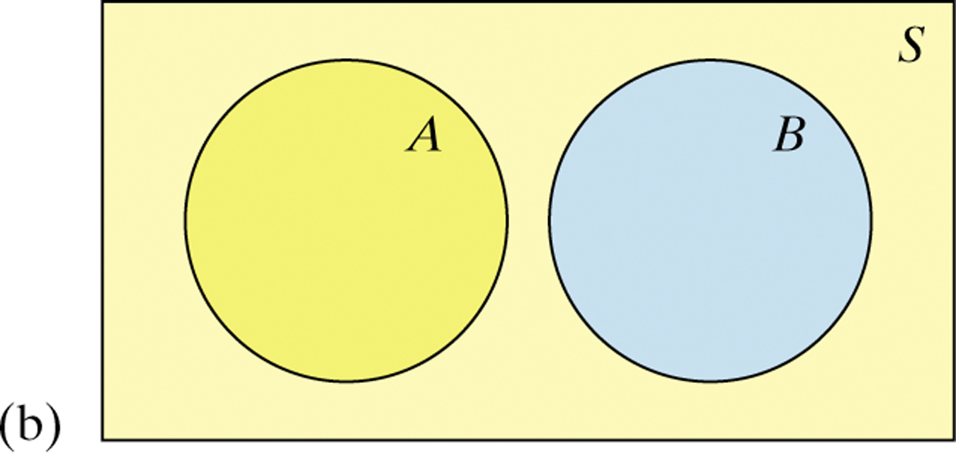
Probability Rules
Venn Diagrams and Probability
Because Venn diagrams have uses in other branches of mathematics, some standard vocabulary and notation have been developed.
The complement A^{C} contains exactly the outcomes that are not in A.
The events A and B are mutually exclusive (disjoint) because they do not overlap. That is, they have no outcomes in common.

Slide 13
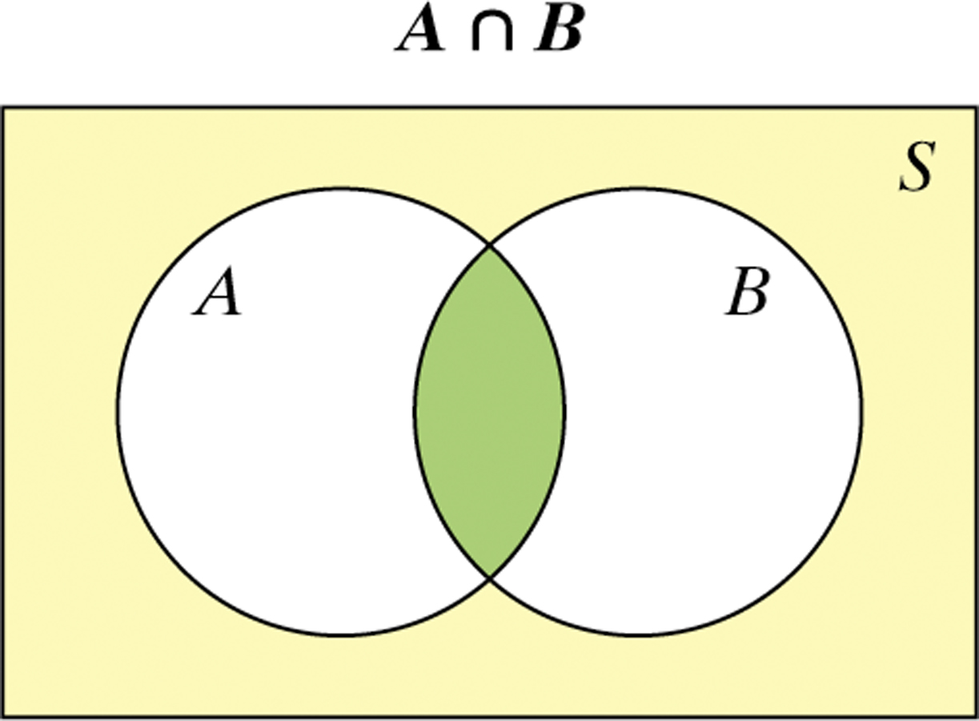
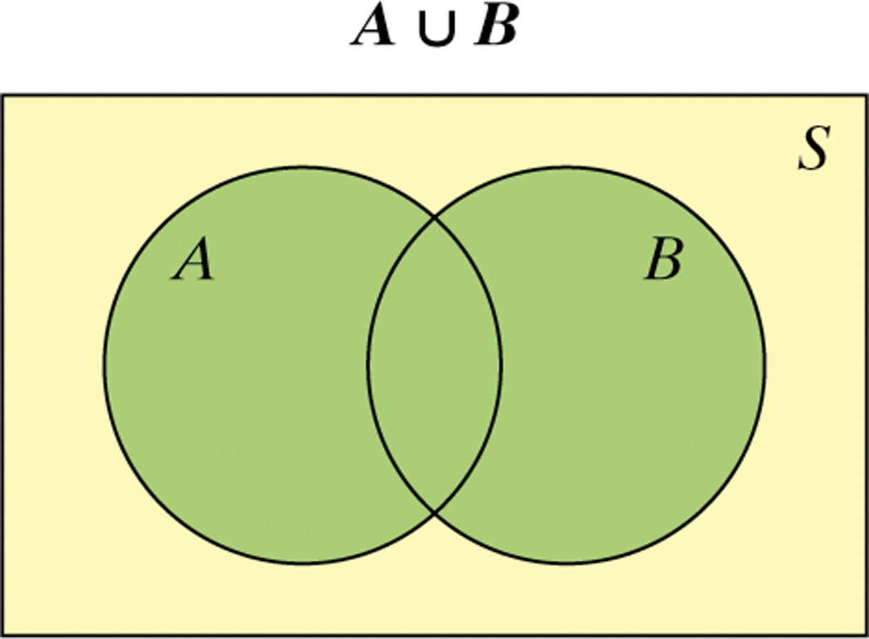
Probability Rules
Venn Diagrams and Probability
The intersection of events A and B (A ∩ B) is the set of all outcomes in both events A and B.
The union of events A and B (A ∪ B) is the set of all outcomes in either event A or B.
Hint: To keep the symbols straight, remember ∪ for union and ∩ for intersection.

Slide 14
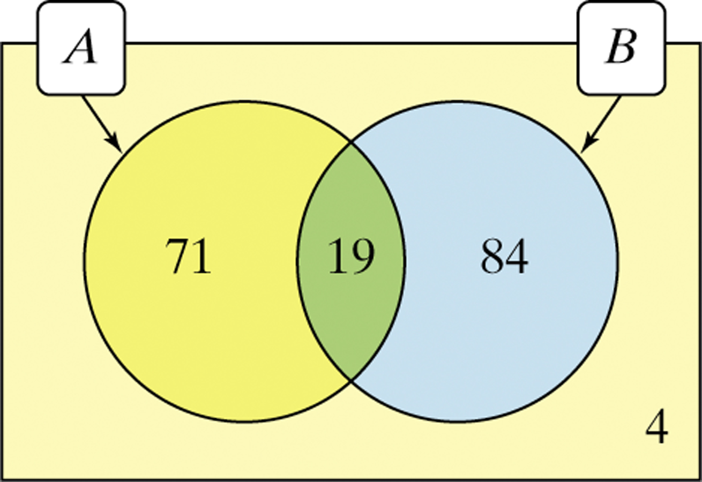
Probability Rules
Venn Diagrams and Probability
Recall the example on gender and pierced ears. We can use a Venn diagram to display the information and determine probabilities.
Define events A: is male and B: has pierced ears.

Slide 15
Section 5.2 Probability Rules
Summary
In this section, we learned that…
A probability model describes chance behavior by listing the possible outcomes in the sample space S and giving the probability that each outcome occurs.
An event is a subset of the possible outcomes in a chance process.
For any event A, 0 ≤ P(A) ≤ 1
P(S) = 1, where S = the sample space
If all outcomes in S are equally likely,
P(A^{C}) = 1 – P(A), where A^{C} is the complement of event A; that is, the event that A does not happen.

Slide 16
Section 5.2 Probability Rules
Summary
In this section, we learned that…
Events A and B are mutually exclusive (disjoint) if they have no outcomes in common. If A and B are disjoint, P(A or B) = P(A) + P(B).
A two-way table or a Venn diagram can be used to display the sample space for a chance process.
The intersection (A ∩ B) of events A and B consists of outcomes in both A and B.
The union (A ∪ B) of events A and B consists of all outcomes in event A, event B, or both.
The general addition rule can be used to find P(A or B):
P(A or B) = P(A) + P(B) – P(A and B)

Slide 17
Looking Ahead…
In the next Section…
We’ll learn how to calculate conditional probabilities as well as probabilities of independent events.
We’ll learn about
Conditional Probability
Independence
Tree diagrams and the general multiplication rule
Special multiplication rule for independent events
Calculating conditional probabilities

