Slide 1
Minimum Wage
Can a person live on it?

Slide 2
Class discussion
Who currently has a job?
If you worked full-time (40 hrs/week), could you support yourself on your current pay-rate?
What is the current minimum wage?
One of the issues in the current presidential election is raising the federal minimum wage. Some propose to $10.10. Others propose to $15. What are the pros and cons to these suggestions?

Slide 3
Will a Higher Minimum Wage Spur Income and Job Growth?
Raising the minimum wage would increase economic activity and spur job growth.
Increasing the minimum wage would force businesses to lay off employees and raise unemployment levels.
Any increase in income for low-wage workers would be completely dedicated to consumption as they try to catch up to the cost of living.
Once the increases and decreases in income for all workers are taken into account, overall real income would rise by $2 billion.*
*https://www.cbo.gov/publication/44995
The Congressional Budget Office has predicted that this proposed wage increase could cost the economy 500,000 jobs.*
A 2014 survey of 1213 business owners finds that 39 percent of respondents would reduce future hiring. Among those employers who currently pay the minimum wage, 54 percent would reduce future hiring.**
*https://www.cbo.gov/publication/45138
**http://www.prweb.com/releases/2014/05/prweb11811070.htm

Slide 4
Will Raising the Minimum Wage Solve the Poverty Problem in the U.S.?
Increasing the minimum wage would reduce poverty.
Raising the minimum wage WON’T HAVE MUCH IMPACT ON poverty.
Based on 2015 poverty thresholds, an increase to $10.10 an hour would elevate a single parent with two children out of poverty.*
According to a 2014 CBO report, this would lift 900,000 people out of poverty.
*https://aspe.hhs.gov/2015-poverty-guidelines#threshholds
57% of poor families with heads of household ages 18–64 have no workers
Some workers are poor not because of low wages but because of low hours
Many low-wage workers, such as teens, are not in poor families
If wages were simply raised to $10.10 with no changes to the number of jobs or hours, only 18% of the total increase in incomes would go to poor families
*http://www.frbsf.org/economic-research/publications/economic-letter/2015/december/reducing-poverty-via-minimum-wages-tax-credit/

Slide 5
WHO MAKES MINIMUM WAGE?
According to the BLS, in 2015 there were 2.6 million wage earners at or below the minimum (some jobs are exempt).
50% are in the food preparation or food serving sector.
63% are women and 55% are over the age of 25, according to the U.S. Department of Labor.
More likely to live in the South than anywhere else, with Florida the only state to adjust higher ($8.05/hour).

Slide 6
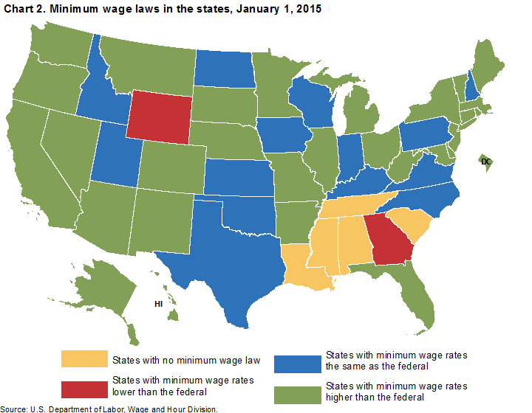
RAISE THE FEDERAL MINIMUM?
States and municipalities are free to set there own minimum hourly wage rate, the higher one prevails.
29 states plus D.C. have established rates higher than the federal $7.25/hour.
At least 30 cities and counties have adopted their own minimum rates.
For example, Washington D.C. has a minimum wage of $10.50/hour and Emeryville, CA of $14.44/hour
*http://laborcenter.berkeley.edu/minimum-wage-living-wage-resources/inventory-of-us-city-and-county-minimum-wage-ordinances/ provides a complete list.

Slide 7
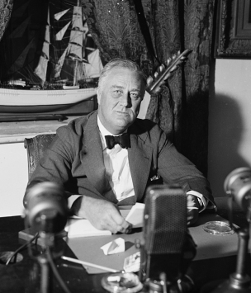
CREATED AT THE END OF THE DEPRESSION
Introduced in 1938 through the Fair Labor Standards Act.
The oversupply of labor and continued use of children in factories led to passage to end the exploitation.
Set a national minimum wage of $0.25 an hour, a 44-hour work week, and the prohibition of "oppressive" child labor.
FDR indicated it was his 2nd most important domestic accomplishment after Social Security.

Slide 8
HISTORY OF FEDERAL MINIMUM WAGE
Use the provided chart from the Department of Labor for the history of the Federal minimum wage
Using the values in the “1938 Act” column, create a graph of the history of the federal minimum wage
Year should be on the x-axis and minimum wage should be on the y-axis
Once you have drawn your graph, write down two observations you have about the graph

Slide 9
22 INCREASES UNDER 12 PRESIDENTS
Animated History of the Minimum Wage
When was the minimum wage highest in today’s dollars?
When was the last time the minimum wage was worth on $7.25 in today’s dollars?
What does this mean in terms of buying power today?

Slide 10
Living Wage
What do you think the term “living wage” means?
Is this different than a minimum wage?
Will this be the same for each person and their specific situat?

Slide 11
Living Wage
Using the Typical Expenses table:
Choose a family size (1, 2 or 3 children)
For each column for this family size as well as the 1 adult column (4 total calculations)
Using the before tax income, calculate the hourly rate required to achieve this income (assume 2,080 hours per year)
Note: when both adults work, use 4,160 hours per year
For each case, compare this to the minimum wage

Slide 12
Living Wage
Did you find situations where it would be very difficult to earn the living wage? Explain
What options do adults have when the living wage is higher than their actual wage?

