Slide 1
Warmup
A study was done comparing the number of registered automatic weapons (in thousands) along with the murder rate (in murders per 100,000) for 8 randomly selected states. The number of registered weapons had a mean of 4.8 and a standard deviation of 3.74 The murder rate had a mean of 8.1and a standard deviation of 3.6. The correlation r = .885.
Find the least square regression line for this relationship?
Predict the murder rate if 10 thousand automatic guns are registered

Slide 2
Least-Squares Regression
Least-Squares Regression Line
We can use technology to find the equation of the least-squares regression line. We can also write it in terms of the means and standard deviations of the two variables and their correlation.
Definition: Equation of the least-squares regression line
We have data on an explanatory variable x and a response variable y for n individuals. From the data, calculate the means and standard deviations of the two variables and their correlation. The least squares regression line is the line ŷ = a + bx with
slope
and y intercept

Slide 3
Example #2
It is believed a student’s Verbal SAT score can be used to predict their Math SAT score. Data for a high school graduating class was compiled and it was found that the mean Verbal score was 596.3 with a standard deviation of 99.5. The Math scores had a mean of 612.2 with a standard deviation of 96.1. If r = .685, find the equation of the regression line.
What would you predict the Math score to be if the Verbal score is 615?

Slide 4
Section 3.2 Least-Squares Regression
Learning Objectives
After this section, you should be able to…
INTERPRET a regression line
CALCULATE the equation of the least-squares regression line
CALCULATE residuals
CONSTRUCT and INTERPRET residual plots
DETERMINE how well a line fits observed data
INTERPRET computer regression output

Slide 5
Least-Squares Regression
Residuals
Definition:
A residual is the difference between an observed value of the response variable and the value predicted by the regression line. That is,
residual = observed y – predicted y
residual = y - ŷ
Using the regression line from Example #2:
Calculate the predicted Math SAT score if a student scored 610 on the Verbal part
John had a Verbal score of 610 and a Math score of 615. What was the residual for John’s result?

Slide 6
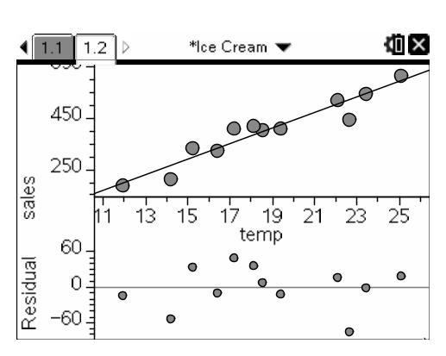
Least-Squares Regression
Residual Plots
One of the first principles of data analysis is to look for an overall pattern and for striking departures from the pattern. A regression line describes the overall pattern of a linear relationship between two variables. We see departures from this pattern by looking at the residuals.
Definition:
A residual plot is a scatterplot of the residuals against the explanatory variable. Residual plots help us assess how well a regression line fits the data.

Slide 7
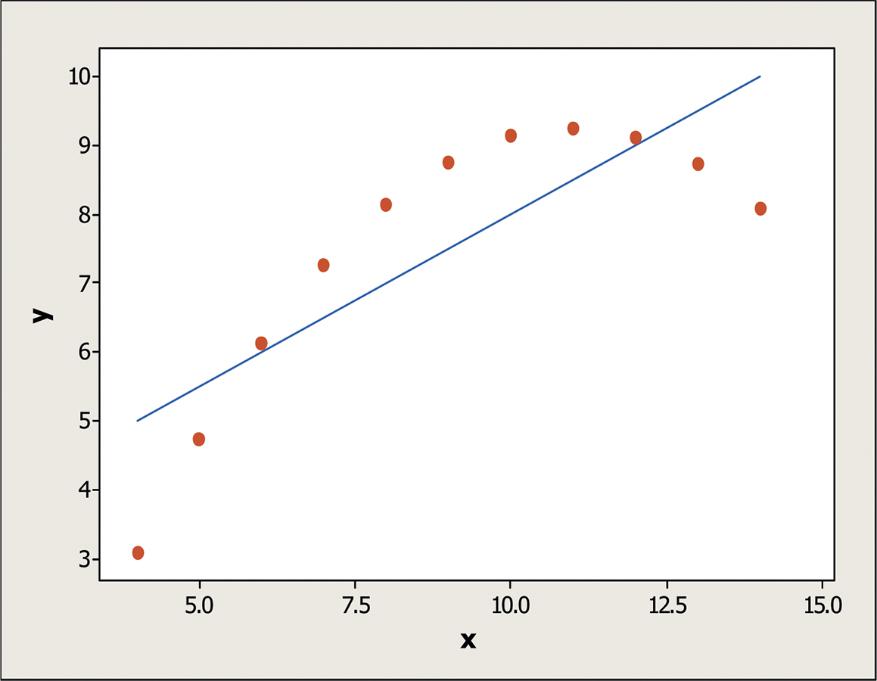
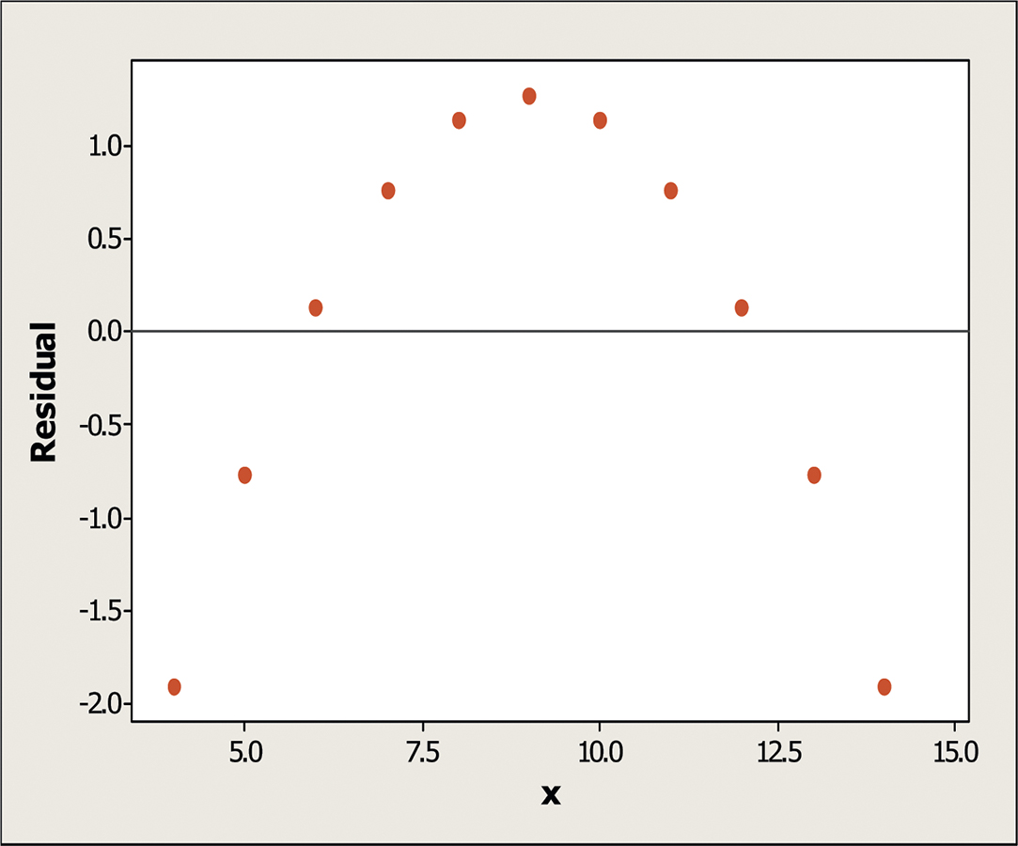
Least-Squares Regression
Interpreting Residual Plots
A residual plot magnifies the deviations of the points from the line, making it easier to see unusual observations and patterns.
The residual plot should show no obvious patterns
The residuals should be relatively small in size.
Pattern in residuals
Linear model not appropriate

Slide 8
Least-Squares Regression
The Role of r² in Regression
There is a numerical quantity that tells us how well the least-squares regression line predicts values of the response y.
Definition:
The coefficient of determination r² is the fraction of the variation in the values of y that is accounted for by the least-squares regression line of y on x.
Consider the body weight vs backpack weight example. We found that r = .794. Calculate r².
This tells us what % of the variation in backpack weight is accounted for by the linear model relating pack weight to body weight.

Slide 9
Least-Squares Regression
Correlation and Regression Wisdom
Correlation and regression are powerful tools for describing the relationship between two variables. When you use these tools, be aware of their limitations
1. The distinction between explanatory and response variables is important in regression.

Slide 10
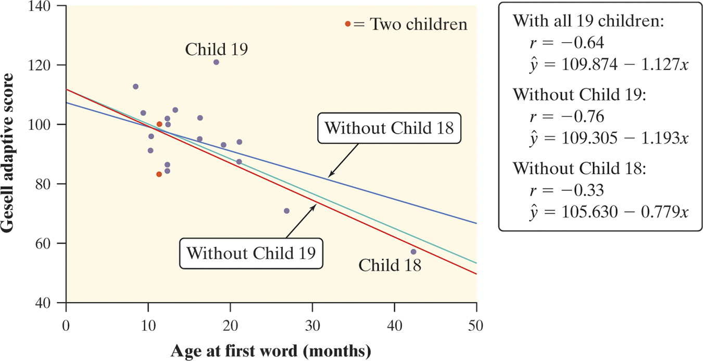
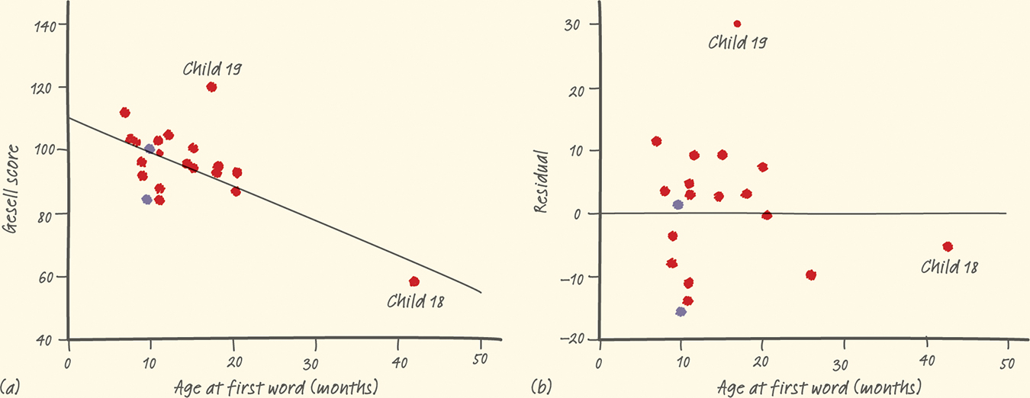
Least-Squares Regression
Correlation and Regression Wisdom
2. Correlation and regression lines describe only linear relationships.
3. Correlation and least-squares regression lines are not resistant.
Definition:
An outlier is an observation that lies outside the overall pattern of the other observations. Points that are outliers in the y direction but not the x direction of a scatterplot have large residuals. Other outliers may not have large residuals.
An observation is influential for a statistical calculation if removing it would markedly change the result of the calculation. Points that are outliers in the x direction of a scatterplot are often influential for the least-squares regression line.

Slide 11
Least-Squares Regression
Correlation and Regression Wisdom
4. Association does not imply causation.
Association Does Not Imply Causation
An association between an explanatory variable x and a response variable y, even if it is very strong, is not by itself good evidence that changes in x actually cause changes in y.
A serious study once found that people with two cars live longer than people who only own one car. Owning three cars is even better, and so on. There is a substantial positive correlation between number of cars x and length of life y. Why?

Slide 12
Section 3.2 Least-Squares Regression
Summary
In this section, we learned that…
A regression line is a straight line that describes how a response variable y changes as an explanatory variable x changes. We can use a regression line to predict the value of y for any value of x.
The slope b of a regression line is the rate at which the predicted response ŷ changes along the line as the explanatory variable x changes. b is the predicted change in y when x increases by 1 unit.
The y intercept a of a regression line is the predicted response for ŷ when the explanatory variable x = 0.
Avoid extrapolation, predicting values outside the range of data from which the line was calculated.

Slide 13
Section 3.2 Least-Squares Regression
Summary
In this section, we learned that…
The least-squares regression line is the straight line ŷ = a + bx that minimizes the sum of the squares of the vertical distances of the observed points from the line.
You can examine the fit of a regression line by studying the residuals (observed y – predicted y). Be on the lookout for points with unusually large residuals and also for nonlinear patterns and uneven variation in the residual plot.
The standard deviation of the residuals s measures the average size of the prediction errors (residuals) when using the regression line.

Slide 14
Section 3.2 Least-Squares Regression
Summary
In this section, we learned that…
The coefficient of determination r² is the fraction of the variation in one variable that is accounted for by least-squares regression on the other variable.
Correlation and regression must be interpreted with caution. Plot the data to be sure the relationship is roughly linear and to detect outliers and influential points.
Be careful not to conclude that there is a cause-and-effect relationship between two variables just because they are strongly associated.

Slide 15
Looking Ahead…
In the next Chapter…
We’ll learn how to properly design studies to produce data.
We’ll learn about
Sampling and Surveys
Experiments
Using Studies Wisely

