Slide 1
WARMUP
George is getting a loan to buy a car. He will borrow $17,000 for 4 years at 7.2%. What are his monthly payments?
How much in finance charges will he pay?

Slide 2
4-3 LOAN CALCULATIONS AND REGRESSION
OBJECTIVES
Analyze how the monthly payment gets allocated
Calculate details of a loan using an amortization schedule

Slide 3
How can you calculate and model loan computations?
How does a loan payment work?
Which of the following change monthly and which remain the same each month?
Monthly payments
Monthly contribution to principal
Monthly contribution to finance charges

Slide 5
Example 1
Determine the total interest owed on a 5-year $10,000 loan at 6% APR.
Example 2
Hannah is taking out a 4.3% loan to purchase an $18,000 car. The length of the loan is 8 years. How much will she pay in interest?

Slide 6
Example 3
Claude wants to borrow $25,000 to purchase a car. After looking at his monthly budget, he realizes that all he can afford to pay per month is $300. The bank is offering a 5.9% loan. What would need to be the length of his loan be so that he can stay within his budget?
Example 4
What impact would an increase in the monthly payment of $50 have on the length of the loan?

Slide 7
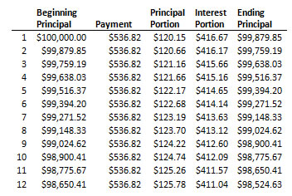
EXAMPLE 5
Here is a loan amortization schedule
What is the loan amount
What is the monthly payment
What is the interest rate
What is the length of the loan
How much interest is paid over the entire loan

Slide 8
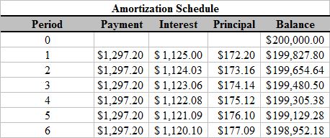
EXAMPLE 6
Here is a loan amortization schedule
What is the loan amount
What is the monthly payment
What is the interest rate
What is the length of the loan
How much interest is paid over the entire loan

