Slide 1
Warmup
Ice Cream Sales vs Temperature
Temperature °C | Ice Cream Sales
14.2° | $215
16.4° | $325
11.9° | $185
15.2° | $332
18.5° | $406
22.1° | $522
19.4° | $412
25.1° | $614
23.4° | $544
18.1° | $421
22.6° | $445
17.2° | $408
What would the explanatory and response variables be?
Find the correlation r
How would you describe this relationship?

Slide 2
Scatterplots and Correlation
Facts about Correlation
How correlation behaves is more important than the details of the formula. Here are some important facts about r.
Correlation makes no distinction between explanatory and response variables.
r does not change when we change the units of measurement of x, y, or both.
The correlation r itself has no unit of measurement.
Correlation does not describe curved relationships between variables, no matter how strong the relationship is.
Correlation is not resistant. r is strongly affected by a few outlying observations.

Slide 3
Section 3.2 Least-Squares Regression
Learning Objectives
After this section, you should be able to…
INTERPRET a regression line
CALCULATE the equation of the least-squares regression line
CALCULATE residuals
CONSTRUCT and INTERPRET residual plots
DETERMINE how well a line fits observed data
INTERPRET computer regression output

Slide 4
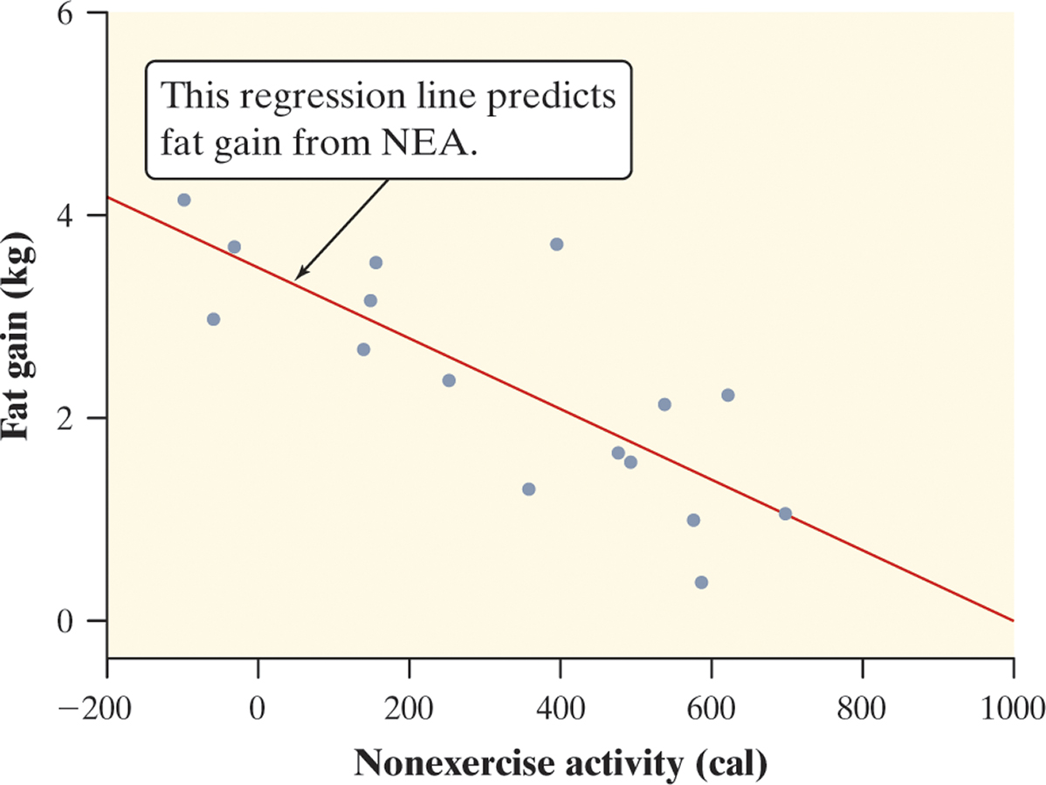
Least-Squares Regression
Regression Line
Linear (straight-line) relationships between two quantitative variables are common and easy to understand. A regression line summarizes the relationship between two variables, but only in settings where one of the variables helps explain or predict the other.
Definition:
A regression line is a line that describes how a response variable y changes as an explanatory variable x changes. We often use a regression line to predict the value of y for a given value of x.
Figure 3.7 on page 165 is a scatterplot of the change in nonexercise activity (cal) and measured fat gain (kg) after 8 weeks for 16 healthy young adults.
The plot shows a moderately strong, negative, linear association between NEA change and fat gain with no outliers.
The regression line predicts fat gain from change in NEA.

Slide 5
Least-Squares Regression
Interpreting a Regression Line
A regression line is a model for the data, much like density curves. The equation of a regression line gives a compact mathematical description of what this model tells us about the relationship between the response variable y and the explanatory variable x.
Definition:
Suppose that y is a response variable (plotted on the vertical axis) and x is an explanatory variable (plotted on the horizontal axis). A regression line relating y to x has an equation of the form
ŷ = a + bx
In this equation,
ŷ (read “y hat”) is the predicted value of the response variable y for a given value of the explanatory variable x.
b is the slope, the amount by which y is predicted to change when x increases by one unit.
a is the y intercept, the predicted value of y when x = 0.

Slide 6
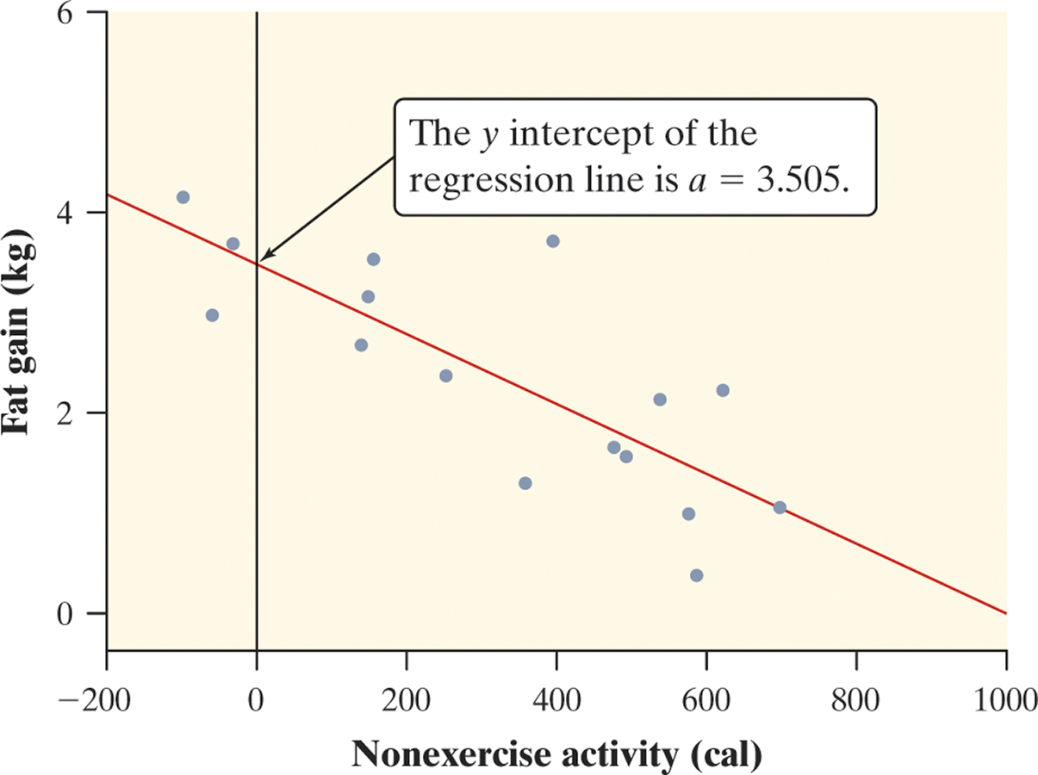
Least-Squares Regression
Interpreting a Regression Line
Consider the regression line from the example “Does Fidgeting Keep You Slim?” Identify the slope and y-intercept and interpret each value in context.
The slope b = -0.00344 tells us that the amount of fat gained is predicted to go down by 0.00344 kg for each added calorie of NEA.
The y-intercept a = 3.505 kg is the fat gain estimated by this model if NEA does not change when a person overeats.

Slide 7
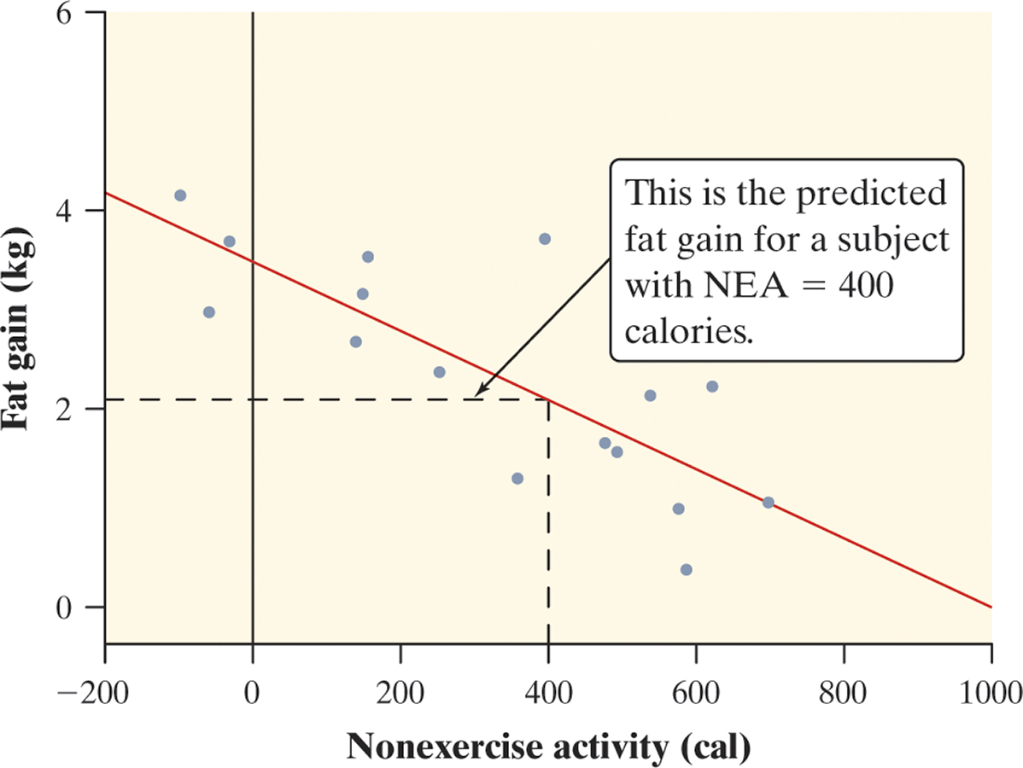
Least-Squares Regression
Prediction
We can use a regression line to predict the response ŷ for a specific value of the explanatory variable x.
Use the NEA and fat gain regression line to predict the fat gain for a person whose NEA increases by 400 cal when she overeats.

Slide 8
Least-Squares Regression
Extrapolation
We can use a regression line to predict the response ŷ for a specific value of the explanatory variable x. The accuracy of the prediction depends on how much the data scatter about the line.
While we can substitute any value of x into the equation of the regression line, we must exercise caution in making predictions outside the observed values of x.
Definition:
Extrapolation is the use of a regression line for prediction far outside the interval of values of the explanatory variable x used to obtain the line. Such predictions are often not accurate.
Don’t make predictions using values of x that are much larger or much smaller than those that actually appear in your data.

Slide 9
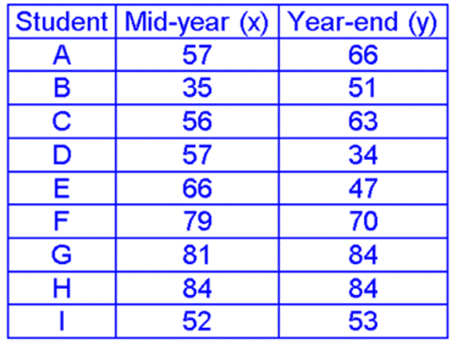
Example
Draw the scatterplot
Draw an estimated line of best fit
Find its equation
4) Predict the yearend grade for a student who had a 70 at midyear.
5) Predict the yearend grade for a student who had a 15 at midyear. Why should we be cautious about this value?

Slide 10
Assignment
Ice Cream Sales vs Temperature
Temperature °C | Ice Cream Sales
14.2° | $215
16.4° | $325
11.9° | $185
15.2° | $332
18.5° | $406
22.1° | $522
19.4° | $412
25.1° | $614
23.4° | $544
18.1° | $421
22.6° | $445
17.2° | $408
Draw the scatterplot
Draw an estimated line of best fit
Find its equation
Predict the sales for a temperature of 20⁰
Predict the sales for a temperature of 30^{0.} Why should we be cautious about this value?

