Slide 2
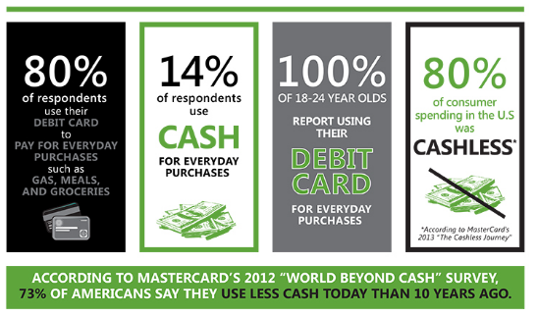

Slide 3
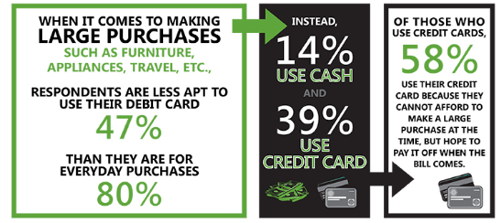

Slide 4
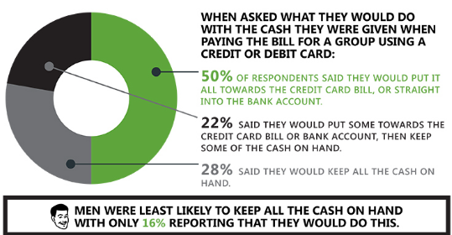

Slide 5
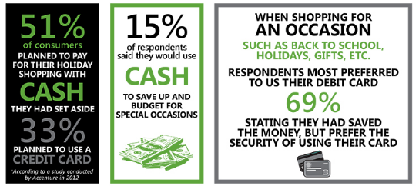

Slide 6
4-1 INTRODUCTION TO CONSUMER CREDIT
OBJECTIVES
Become familiar with the basic vocabulary of credit terms.
Become familiar with types of lending institutions.
Compute finance charges for installment purchases.

Slide 7
Key Terms
credit
debtor
creditor
asset
earning power
credit rating
credit reporting agency
FICO score
installment plan
down payment
interest
finance charge

Slide 8
What do you need to know before using credit?
Why does credit compel people to overspend?
Have you ever seen an advertisement about obtaining your credit score on TV, on radio, or in print media?
How is your credit score like a credit “report card?”

Slide 9
Example 1
Heather wants to purchase an electric guitar. The price of the guitar with tax is $2,240. If she can save $90 per month, how long will it take her to save up for the guitar?

Slide 10
CHECK YOUR UNDERSTANDING
If Roberto wanted to buy a new iPad for $595, how long would it take for him to save for it if he saves $40 per month?

Slide 11
Example 2
Heather, from Example 1, speaks to the salesperson at the music store who suggests that she buy the guitar on the installment plan. It requires a 15% down payment. The remainder, plus an additional finance charge, is paid back on a monthly basis for the next two years. The monthly payment is $88.75. What is the finance charge?

Slide 12
CHECK YOUR UNDERSTANDING
Roberto is offered a way to get the iPad right away. If he puts $100 down, he must then pay $50 per month for 12 months. How much did he pay in finance charges?

Slide 13
EXAMPLE 3
Carpet King is trying to increase sales, and it has instituted a new promotion. All purchases can be paid on the installment plan with no interest, as long as the total is paid in full within six months. There is a $20 minimum monthly payment required. If the Schuster family buys carpeting for $2,134 and makes only the minimum payment for five months, how much will they have to pay in the sixth month?

Slide 14
CHECK YOUR UNDERSTANDING
The Whittendale family purchases a new refrigerator on a no-interest-for-one-year plan. The cost is $1,385. There is no down payment. If they make a monthly payment of $55 until the last month, how much must they pay in the 12th month to avoid finance charges?

Slide 15
EXAMPLE 4
Mike has a credit rating of 720. Tyler has a credit rating of 560. Mike and Tyler apply for identical loans from Park Bank. Mike is approved for a loan at 5.2% interest, and Tyler is approved for a loan that charged 3 percentage points higher because of his inferior credit rating. What interest rate is Tyler charged?

Slide 16
CHECK YOUR UNDERSTANDING
Janet had a credit score of 660. She then missed three monthly payments on her credit cards, and her score was lowered 40 points. What is her new credit score?

