Slide 1
Warmup
At one particular Virginia high school, the math department consists of 20 teachers. Their ages are as follows:
54 58 60 43 35 32 47 28 33 42
65 73 44 27 32 35 28 25 48 33
Draw a stemplot
Describe the distribution (SOCS)

Slide 2
Section 1.2
Displaying Quantitative Data with Graphs
Learning Objectives
After this section, you should be able to…
  CONSTRUCT and INTERPRET dotplots, stemplots, and histograms
  DESCRIBE the shape of a distribution
  COMPARE distributions
  USE histograms wisely

Slide 3
Displaying Quantitative Data
Histograms
  Quantitative variables often take many values. A graph of the distribution may be clearer if nearby values are grouped together.
  The most common graph of the distribution of one quantitative variable is a histogram.
How to Make a Histogram
Divide the range of data into classes of equal width.
Find the count (frequency) or percent (relative frequency) of individuals in each class.
Label and scale your axes and draw the histogram. The height of the bar equals its frequency. Adjacent bars should touch, unless a class contains no individuals.

Slide 4
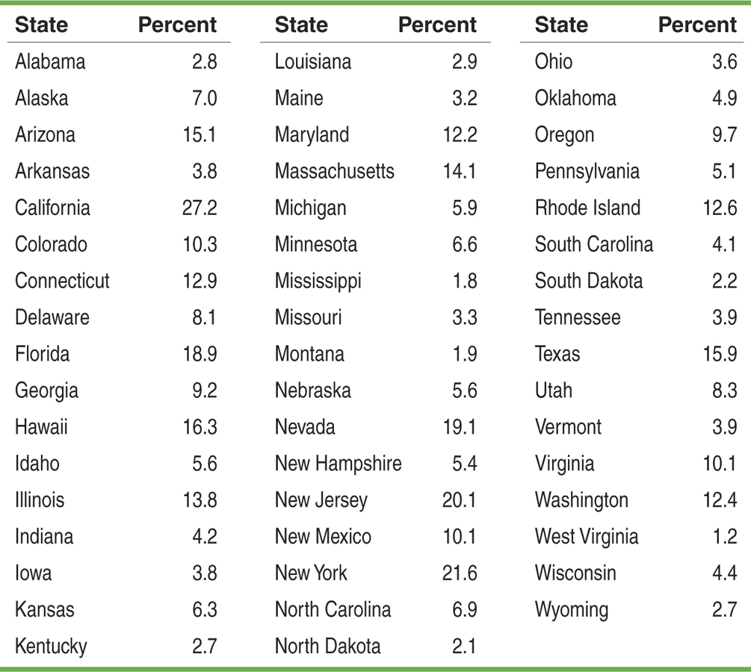
Percent of foreign-born residents by state
Pg. 35

Slide 5
Making a Histogram
The table on page 35 presents data on the percent of residents from each state who were born outside of the U.S.
Example, page 35
Displaying Quantitative Data
Frequency Table
Class | Count
0 to <5 | 20
5 to <10 | 13
10 to <15 | 9
15 to <20 | 5
20 to <25 | 2
25 to <30 | 1
Total | 50
Number of States
Percent of foreign-born residents

Slide 6
Displaying Quantitative Data
Using Histograms Wisely
  Here are several cautions based on common mistakes students make when using histograms.
Cautions
Don’t confuse histograms and bar graphs.
Don’t use counts (in a frequency table) or percents (in a relative frequency table) as data.
Use percents instead of counts on the vertical axis when comparing distributions with different numbers of observations.
Just because a graph looks nice, it’s not necessarily a meaningful display of data.

Slide 7
Section 1.3
Describing Quantitative Data with Numbers
Learning Objectives
After this section, you should be able to…
  MEASURE center with the mean and median
  MEASURE spread with standard deviation and interquartile range
  IDENTIFY outliers
  CONSTRUCT a boxplot using the five-number summary
  CALCULATE numerical summaries with technology

Slide 8
Describing Quantitative Data
Measuring Center: The Mean
  The most common measure of center is the ordinary arithmetic average, or mean.
Definition:
To find the mean (pronounced “x-bar”) of a set of observations, add their values and divide by the number of observations.
In mathematics, the capital Greek letter Σis short for “add them all up.” Therefore, the formula for the mean can be written in more compact notation:

Slide 9
Describing Quantitative Data
Measuring Center: The Median
  Another common measure of center is the median.
Definition:
The median M is the midpoint of a distribution, the number such that half of the observations are smaller and the other half are larger.
To find the median of a distribution:
Arrange all observations from smallest to largest.
If the number of observations n is odd, the median M is the center observation in the ordered list.
If the number of observations n is even, the median M is the average of the two center observations in the ordered list.

Slide 10
Describing Quantitative Data
Comparing the Mean and the Median
The mean and median measure center in different ways, and both are useful.
  Don’t confuse the “average” value of a variable (the mean) with its “typical” value, which we might describe by the median.
Comparing the Mean and the Median
The mean and median of a roughly symmetric distribution are close together.
If the distribution is exactly symmetric, the mean and median are exactly the same.
In a skewed distribution, the mean is usually farther out in the long tail than is the median.

Slide 11
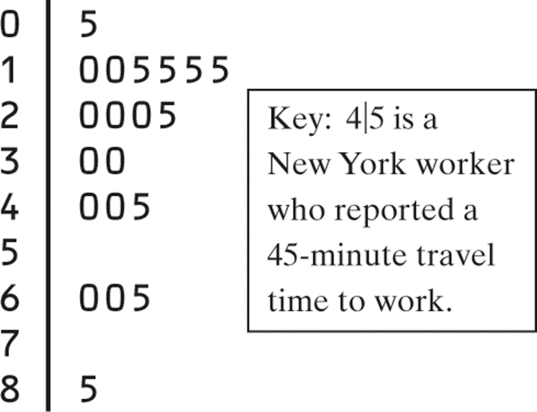
CHECK YOUR UNDERSTANDING
What is the shape of the distribution?
What is the median?
Will the mean be smaller or larger than the median (don’t calculate)
Confirm your answer by calculating the mean
Is the mean or median a better measure of center?

Slide 12
Describing Quantitative Data
Measuring Spread: The Interquartile Range (IQR)
  A measure of center alone can be misleading.
  A useful numerical description of a distribution requires both a measure of center and a measure of spread.
How to Calculate the Quartiles and the Interquartile Range
To calculate the quartiles:
Arrange the observations in increasing order and locate the median M.
The first quartile Q₁ is the median of the observations located to the left of the median in the ordered list.
The third quartile Q₃ is the median of the observations located to the right of the median in the ordered list.
The interquartile range (IQR) is defined as:
IQR = Q₃ – Q₁

Slide 13
Describing Quantitative Data
Identifying Outliers
  In addition to serving as a measure of spread, the interquartile range (IQR) is used as part of a rule of thumb for identifying outliers.
Definition:
The 1.5 x IQR Rule for Outliers
Call an observation an outlier if it falls more than 1.5 x IQR above the third quartile or below the first quartile.

