Slide 1
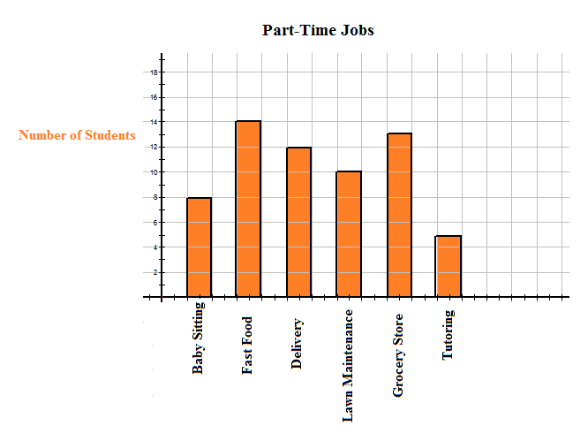
Warmup
Which part-time jobs employed 10 or more of the students?
What percentage of the students worked as a delivery person?

Slide 2
Warmup (Pt. 2)
Find the marginal distribution of ice cream flavors
Display it using a bar graph

Slide 3
Analyzing Categorical Data
Relationships Between Categorical Variables
Marginal distributions tell us nothing about the relationship between two variables.
Definition:
A Conditional Distribution of a variable describes the values of that variable among individuals who have a specific value of another variable.
To examine or compare conditional distributions,
Select the row(s) or column(s) of interest.
Use the data in the table to calculate the conditional distribution (in percents) of the row(s) or column(s).

Slide 4
Analyzing Categorical Data
Two-Way Tables and Conditional Distributions
Young adults by gender and chance of getting rich
 | Female | Male | Total
Almost no chance | 96 | 98 | 194
Some chance, but probably not | 426 | 286 | 712
A 50-50 chance | 696 | 720 | 1416
A good chance | 663 | 758 | 1421
Almost certain | 486 | 597 | 1083
Total | 2367 | 2459 | 4826
Calculate the conditional distribution of opinion among males.

Slide 5
Analyzing Categorical Data
Two-Way Tables and Conditional Distributions
Young adults by gender and chance of getting rich
 | Female | Male | Total
Almost no chance | 96 | 98 | 194
Some chance, but probably not | 426 | 286 | 712
A 50-50 chance | 696 | 720 | 1416
A good chance | 663 | 758 | 1421
Almost certain | 486 | 597 | 1083
Total | 2367 | 2459 | 4826
Calculate the conditional distribution of opinion among females.

Slide 6
Analyzing Categorical Data
Two-Way Tables and Conditional Distributions
Young adults by gender and chance of getting rich
 | Female | Male | Total
Almost no chance | 96 | 98 | 194
Some chance, but probably not | 426 | 286 | 712
A 50-50 chance | 696 | 720 | 1416
A good chance | 663 | 758 | 1421
Almost certain | 486 | 597 | 1083
Total | 2367 | 2459 | 4826
- Calculate the conditional distribution of genders among the opinion “a 50-50 chance”.
- Calculate the conditional distribution of genders among the opinion “some chance but probability not”.

Slide 8
Section 1.1 Analyzing Categorical Data
Summary
In this section, we learned that…
The distribution of a categorical variable lists the categories and gives the count or percent of individuals that fall into each category.
Pie charts and bar graphs display the distribution of a categorical variable.
A two-way table of counts organizes data about two categorical variables.
The row-totals and column-totals in a two-way table give the marginal distributions of the two individual variables.
There are two sets of conditional distributions for a two-way table.

