Slide 1
Drill
Get an iRespond remote and calculator
You will providing the interest rate per compounding period
For example: 8% compounded quarterly, you would divide 8% by 4 to get 2% per quarter
You will have 30 seconds for each question!!

Slide 2
#1
7% compounded annually
7%
3.5%
1.75%
.07%

Slide 3
#2
10% compounded semi-annually
10%
5%
1%
.1%

Slide 4
#3
6% compounded quarterly
6%
3%
1.5%
.5%

Slide 5
#4
8% compounded monthly
8%
4%
2%
.67%

Slide 6
#5
4% compounded daily
4%
2%
1%
.01%

Slide 7
#6
12% compounded quarterly
12%
6%
3%
1%

Slide 8
#7
3% compounded monthly
3%
36%
1%
.25%

Slide 9
#8
9% compounded semi-annually
9%
4.5%
1%
.75%

Slide 10
WARMUP
If you deposit $500 in an account earning 8% interest, compounded quarterly, what is the balance after 6 months?
The beginning balance in Omari’s account on Aug 15th was $482.71. The account earns 4% interest, compounded daily. On Aug 15th, he withdrew $70. On August 16th, he deposited a paycheck for $247.20. What was his ending balance on August 16th?

Slide 11
3-5 COMPOUND INTEREST FORMULA
OBJECTIVES
Make computations using the compound interest formula.

Slide 12
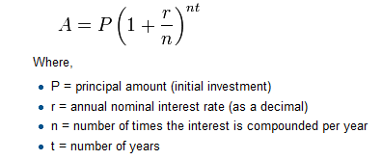
Compound Interest Formula

Slide 13
Example 1
Jose opens a savings account with $2,000 dollars that pays 5% interest, compounded quarterly. What will his ending balance be after one year?

Slide 14
CHECK YOUR UNDERSTANDING
Rico deposits $800 at 3.87% interest, compounded quarterly. What is his ending balance after one year? Round to the nearest cent.

Slide 15
Example 2
If you deposit $2,000 dollars for one year at 5% compounded daily, find the ending balance.

Slide 16
CHECK YOUR UNDERSTANDING
Nancy deposits $1,200 into an account that pays 3% interest, compounded monthly. What is her ending balance after one year? Round to the nearest cent.

Slide 17
EXTEND YOUR UNDERSTANDING
Nancy receives two offers in the mail from other banks. One is an account that pays 2.78% compounded daily. The other account pays 3.25% compounded quarterly. Would either of these accounts provide Nancy with a better return than her current account? If so, which account?

Slide 18
EXAMPLE 3
Marie deposits $1,650 for three years at 3% interest, compounded daily. What is her ending balance?

Slide 19
CHECK YOUR UNDERSTANDING
Kate deposits $2,350 in an account that earns interest at a rate of 3.1%, compounded monthly. What is her ending balance after five years? Round to the nearest cent.

Slide 20
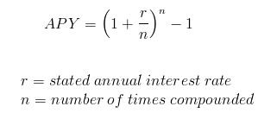
Annual Percentage Yield (APY)
APY – equivalent annual interest rate after compounding

Slide 21
EXAMPLE 4
Sharon deposits $8,000 in a one year CD at 3.2% interest, compounded daily. What is Sharon’s annual percentage yield (APY) to the nearest hundredth of a percent?

Slide 22
CHECK YOUR UNDERSTANDING
Barbara deposits $3,000 in a one year CD at 4.1% interest, compounded daily. What is the APY to the nearest hundredth of a percent?

