Slide 1
PLEASE NOTE!!
If you have not completed your Checking Account Project yet, you have 30 minutes to work on it. It is a project grade
To get reminders about tests, quizzes and other items, please send a text to 81010 with @ah2efg in the message field

Slide 2
3-4 EXPLORE COMPOUND INTEREST
OBJECTIVES
Understand the concept of getting interest on your interest.
Compute compound interest

Slide 3
What is compound interest?
Compound interest is money earned on money deposited plus previous interest
Compounding can be:
Annually
Semiannually
Quarterly
Monthly
Daily

Slide 4
Example 1
How much interest would $1,000 earn in one year at a rate of 6%, compounded annually? What would be the new balance?

Slide 5
Example 2
Maria deposits $1,000 in a savings account that pays 6% interest, compounded semiannually. What is her balance after one year?
CHECK YOUR UNDERSTANDING
Alex deposits $4,000 in a savings account that pays 5% interest, compounded semiannually. What is his balance after one year?

Slide 6
EXAMPLE 3
How much interest does $1,000 earn in three months at an interest rate of 6%, compounded quarterly? What is the balance after three months?

Slide 7
EXAMPLE 4
How much interest does $1,000 earn in one day at an interest rate of 6%, compounded daily? What is the balance after a day?

Slide 8
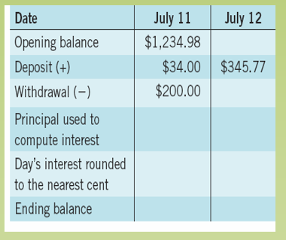
Example 5
Jennifer has a bank account that compounds interest daily at a rate of 3.2%. On July 11, the principal is $1,234.98. She withdraws $200 for a car repair. She receives a $34 check from her health insurance company and deposits it. On July 12, she deposits her $345.77 paycheck. What is her balance at the end of the day on July 12?

Slide 9
CHECK YOUR UNDERSTANDING
On January 7, Joelle opened a savings account with $900. It earned 3% interest, compounded daily. On January 8, she deposited her first paycheck of $76.22. What was her balance at the end of the day on January 8?

