Slide 1
Normal Distributions
Warmup

Slide 2
Section 2.2 Normal Distributions
Learning Objectives
After this section, you should be able to…
DESCRIBE and APPLY the 68-95-99.7 Rule
DESCRIBE the standard Normal Distribution
PERFORM Normal distribution calculations
ASSESS Normality

Slide 3
Normal Distributions
Using Table A backwards
The height of adult females is N(64.5, 2.5).
How tall is a female to be in the shortest 40%?
What are the range of heights to be in the middle 80%?

Slide 4
Normal Distributions
Assessing Normality
The Normal distributions provide good models for some distributions of real data. Many statistical inference procedures are based on the assumption that the population is approximately Normally distributed. Consequently, we need a strategy for assessing Normality.
Plot the data.
Make a dotplot, stemplot, or histogram and see if the graph is approximately symmetric and bell-shaped.
Check whether the data follow the 68-95-99.7 rule.
Count how many observations fall within one, two, and three standard deviations of the mean and check to see if these percents are close to the 68%, 95%, and 99.7% targets for a Normal distribution.

Slide 5
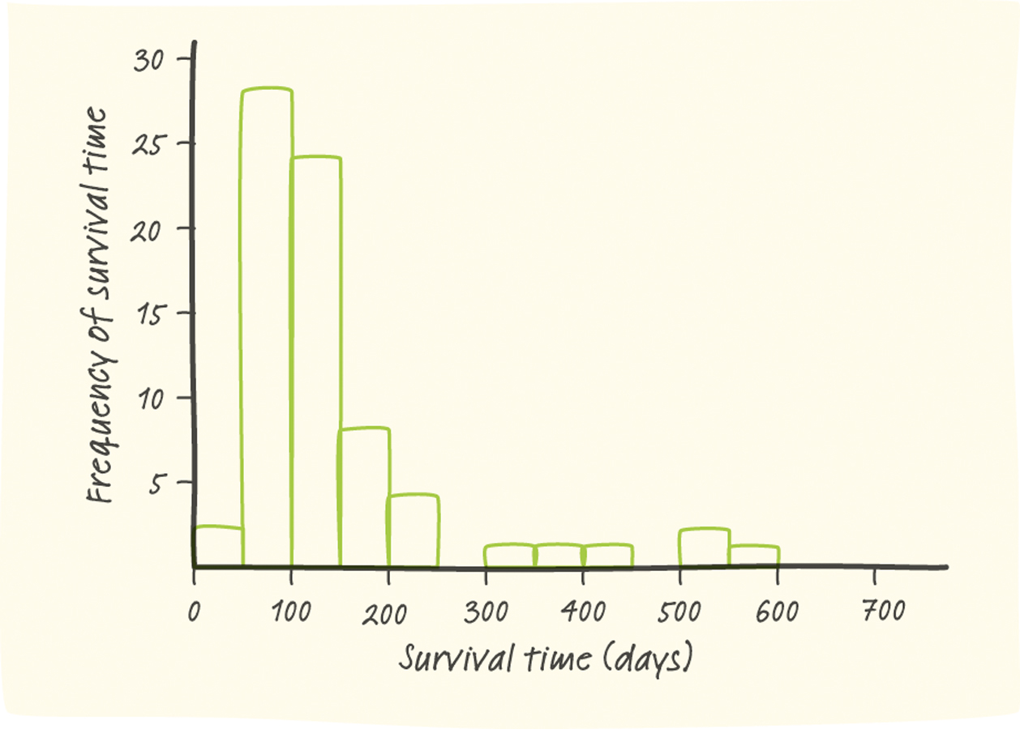
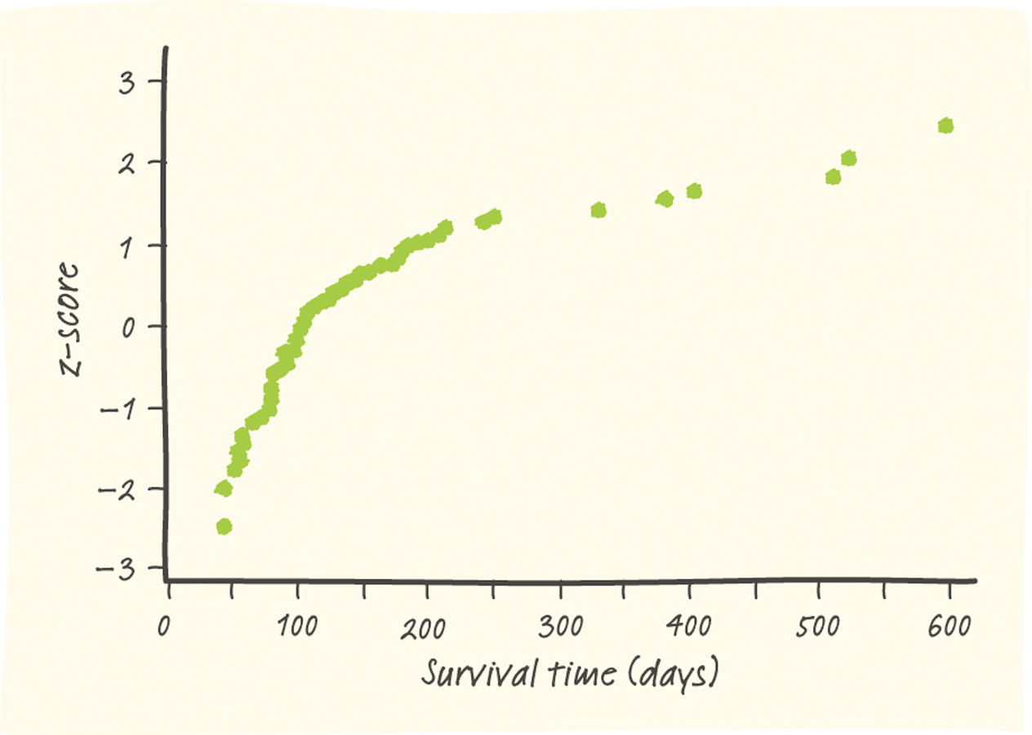
Normal Distributions
Normal Probability Plots
Most software packages can construct Normal probability plots. These plots are constructed by plotting each observation in a data set against its corresponding percentile’s z-score.
Interpreting Normal Probability Plots
If the points on a Normal probability plot lie close to a straight line, the plot indicates that the data are Normal. Systematic deviations from a straight line indicate a non-Normal distribution. Outliers appear as points that are far away from the overall pattern of the plot.

